Slide 1




A programming language specifically made for scientists
Carsten Bauer @ University of Cologne, October 2019

Slide 2
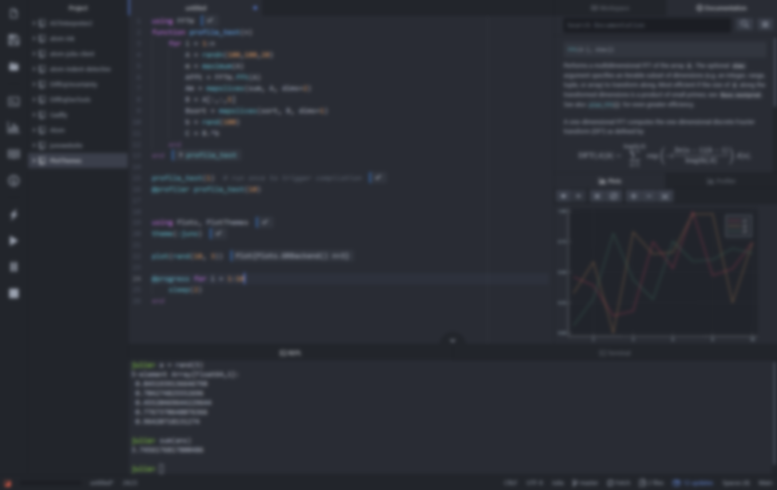

The programming language for scientists
Carsten Bauer @ University of Cologne, October 2019

Slide 3
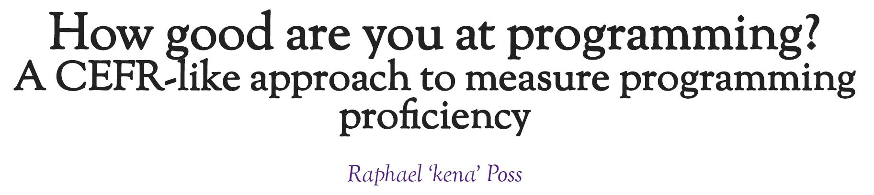
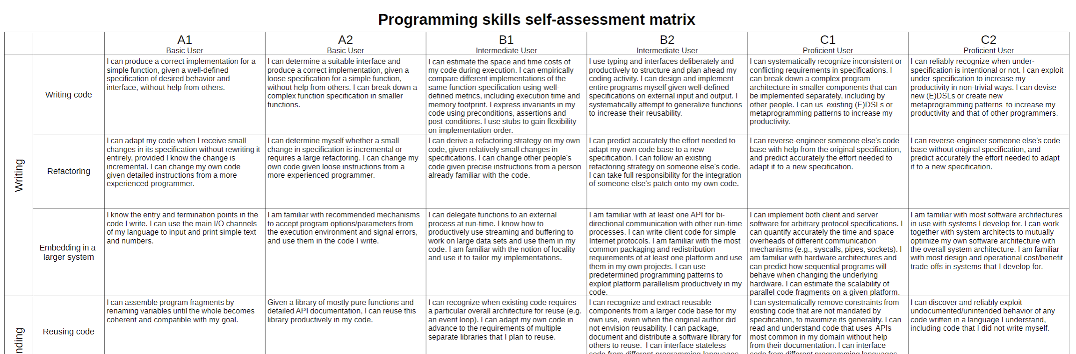
https://science.raphael.poss.name/programming-levels.html
Notes:
Common European Framework of Reference for Languages – language proficiency

Slide 4








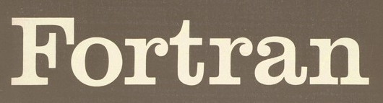
There’s a plethora of programming languages

Slide 5
There’s a plethora of programming languages

Slide 6
There’s a plethora of programming languages
Slow(ish)
Fast

Slide 7
There’s a plethora of programming languages
Static
Dynamic

Slide 8
There’s a plethora of programming languages
Compiled
Interpreted

Slide 9
The two-language problem
For convenience, use a scripting language
but do all the hard stuff in a “systems language”
Shows up as black box packages in scripting languages
Creates a social barrier – a wall between users and developers

Slide 10
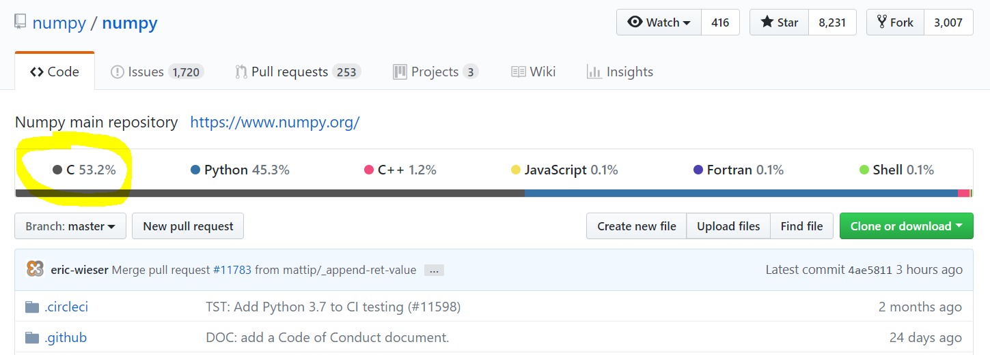

Slide 11
The two-language problem
static
dynamic
compiled
interpreted
user types
standard types
standalone
glue

Slide 12
dynamic
compiled
user types
and
standard types
standalone
or
glue

Slide 13
The unification
dynamic
compiled
user types
and
standard types
standalone
or
glue

Slide 14
What do we want from a PL?
The unification
Simple yntax + grammar
Simple syntax + grammar
Fast answers
Interactivity
“Feels like Python, runs like C”

Slide 15
What do we want from a PL?
The unification
function babylonian(α; N = 10)
@assert α > 0 "α must be > 0"
t = (1+α)/2
for i = 2:N
t = (t + α/t)/2
end
t
end
babylonian(π) ≈ √π
Simple syntax + grammar
Fast answers
Interactivity
“Feels like Python, runs like C”

Slide 16
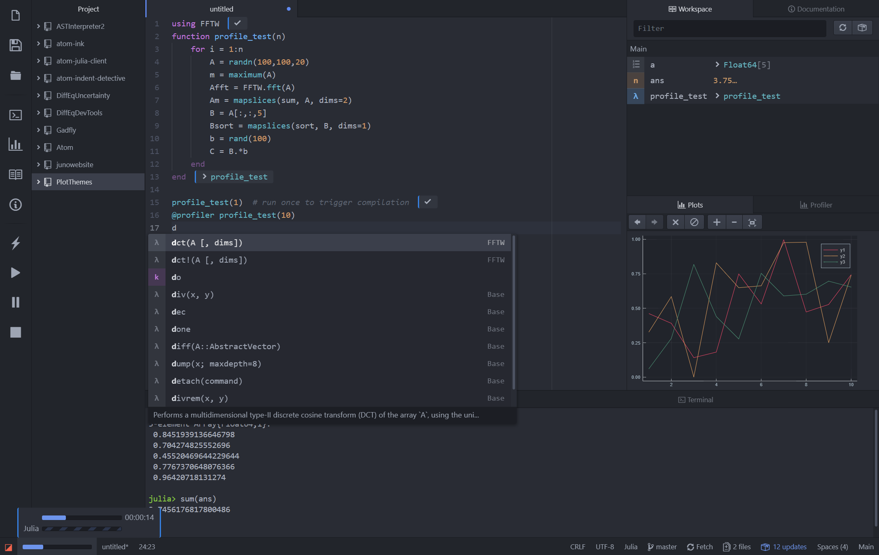
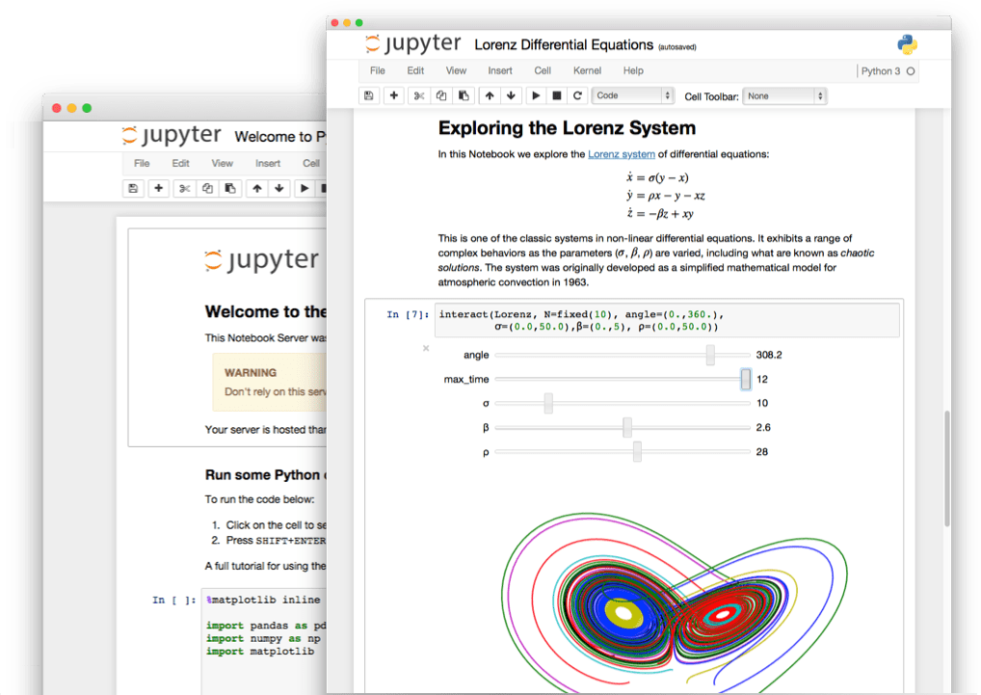
What do we want from a PL?
The unification
Simple yntax + grammar
Simple syntax + grammar
Fast answers
Interactivity
“Feels like Python, runs like C”

Slide 17
What do we want from a PL?
The unification
julia> function sumup()
x = 0
for i in 1:100
x += i
end
x
end
sumup (generic function with 2 methods)
julia> @code_llvm debuginfo=:none sumup()
; Function Attrs: uwtable
define i64 @julia_sumup_12626() #0 {
top:
ret i64 5050
}
Simple yntax + grammar
Simple syntax + grammar
Fast answers
Interactivity
Just returns the answer!
(The for loop was compiled away)
“Feels like Python, runs like C”

Slide 18
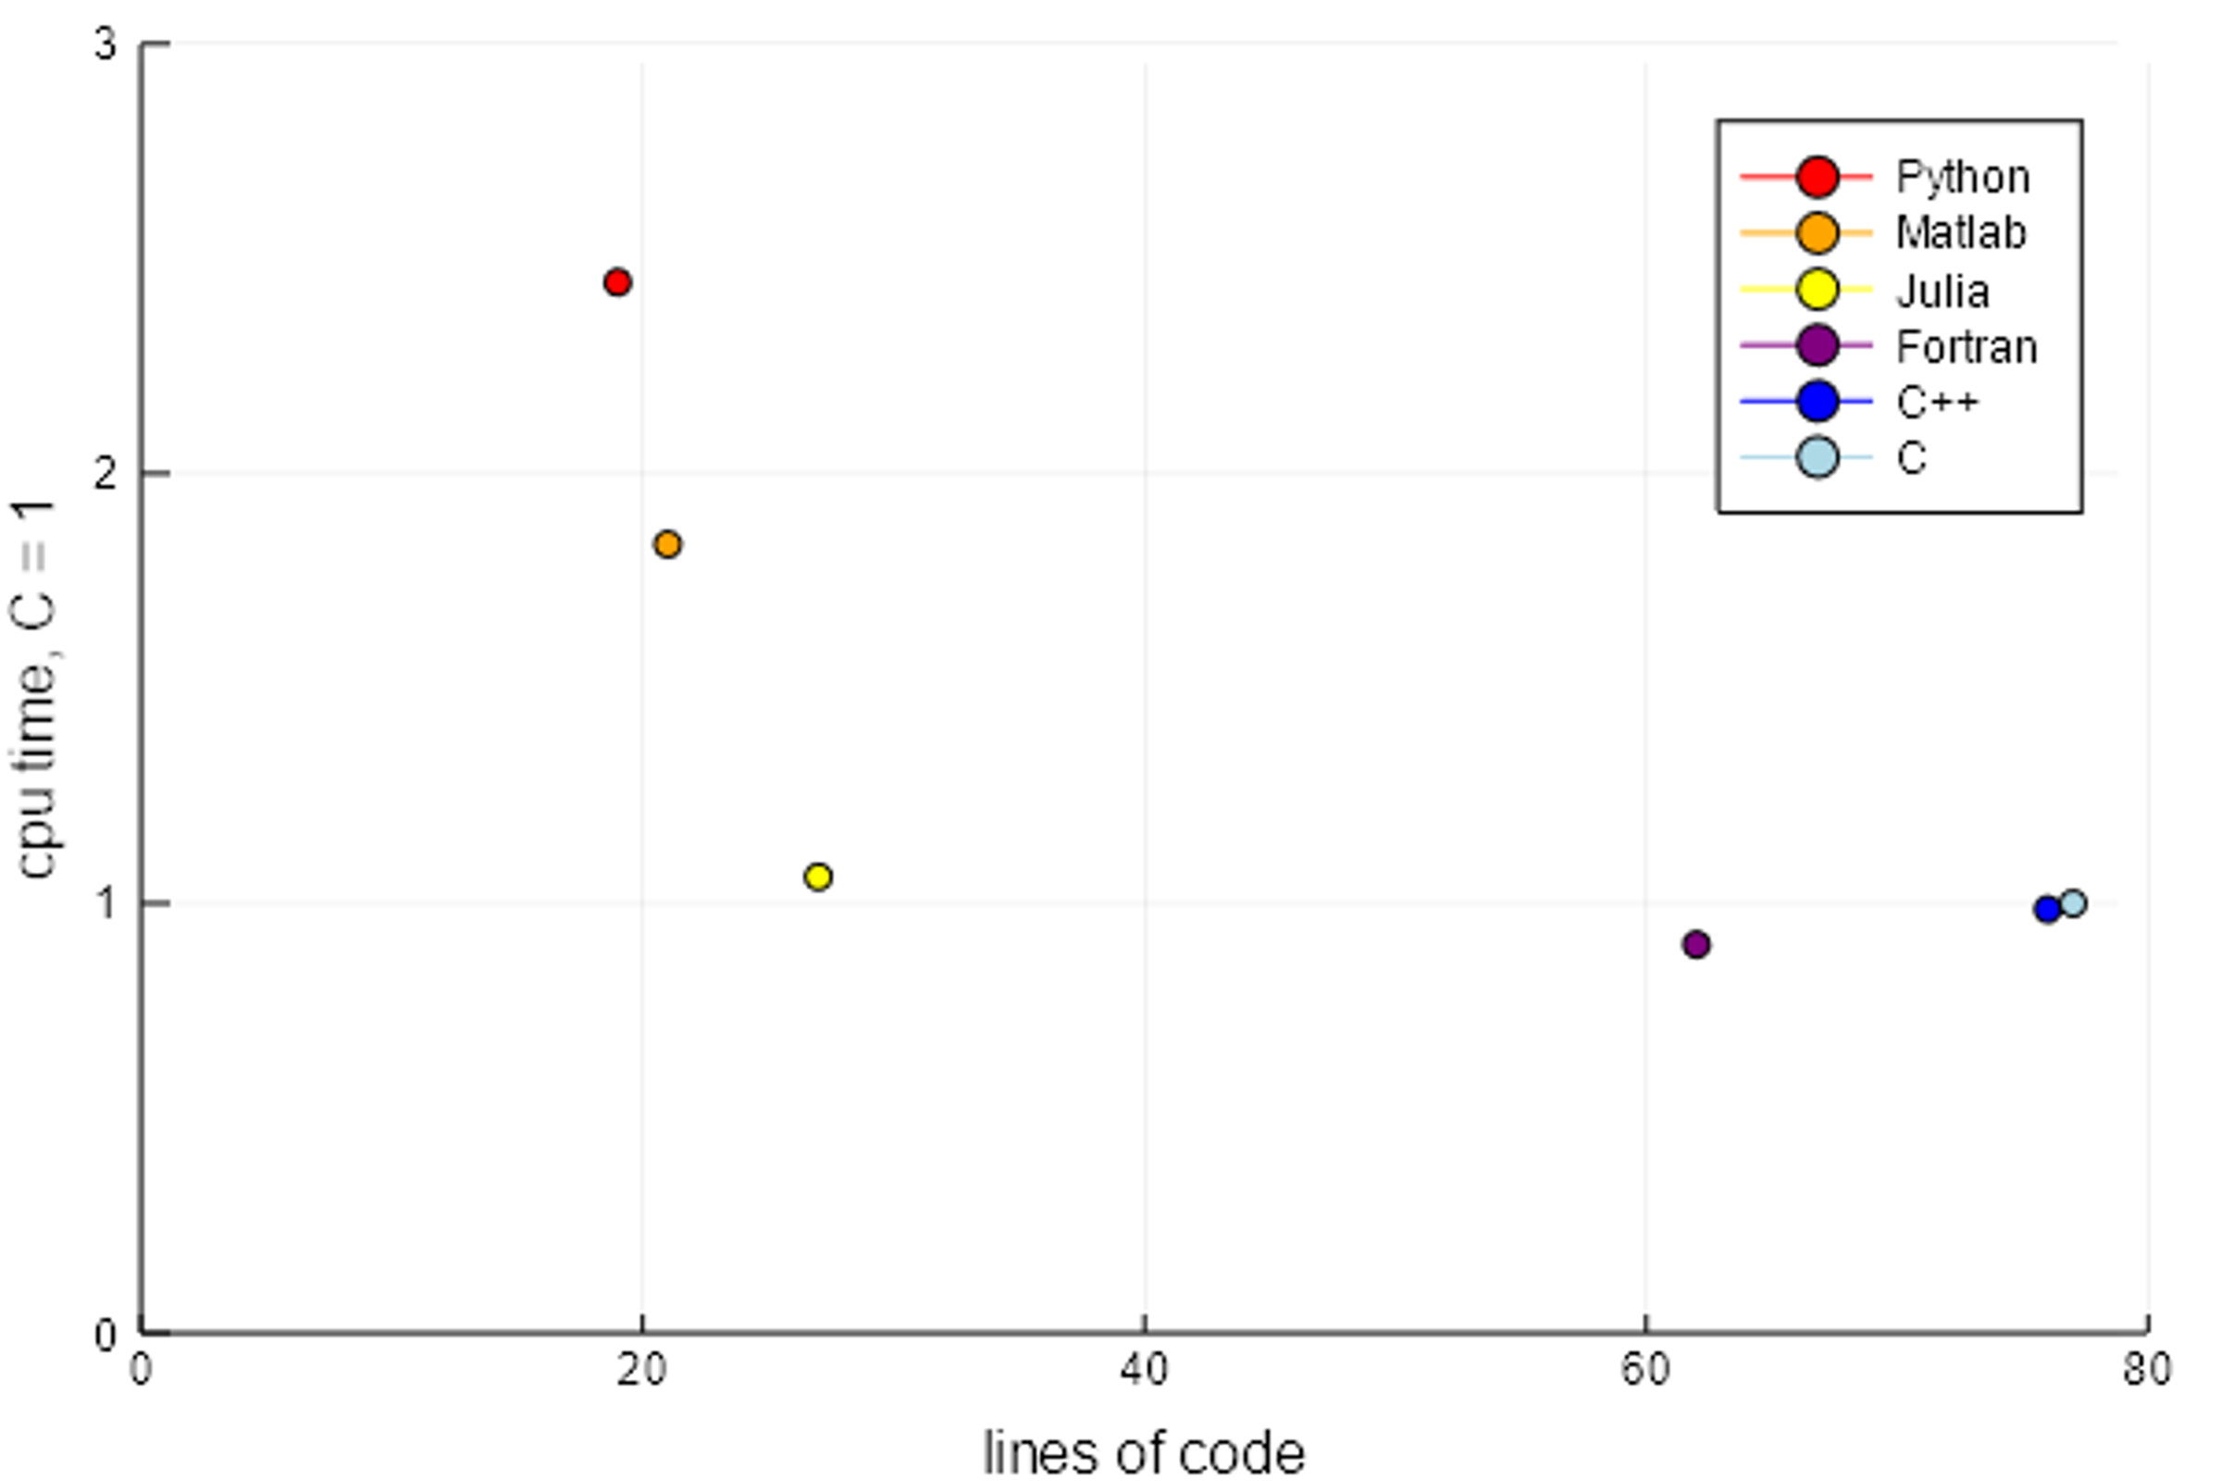
It is expressive

Slide 19
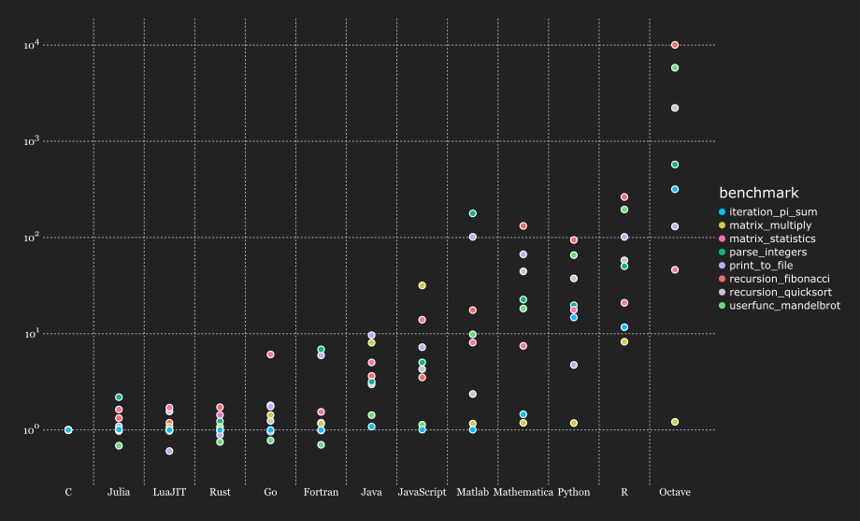
It is fast

Slide 20
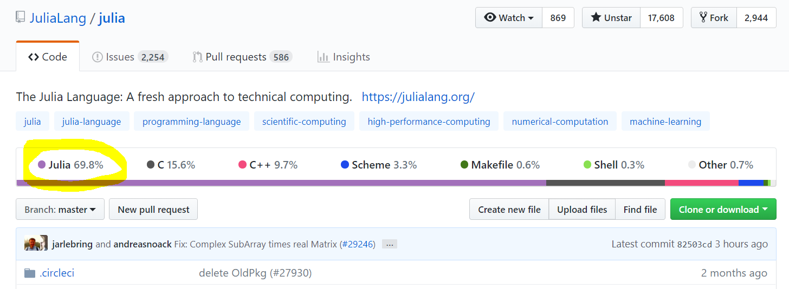
It is free and open source

Slide 21
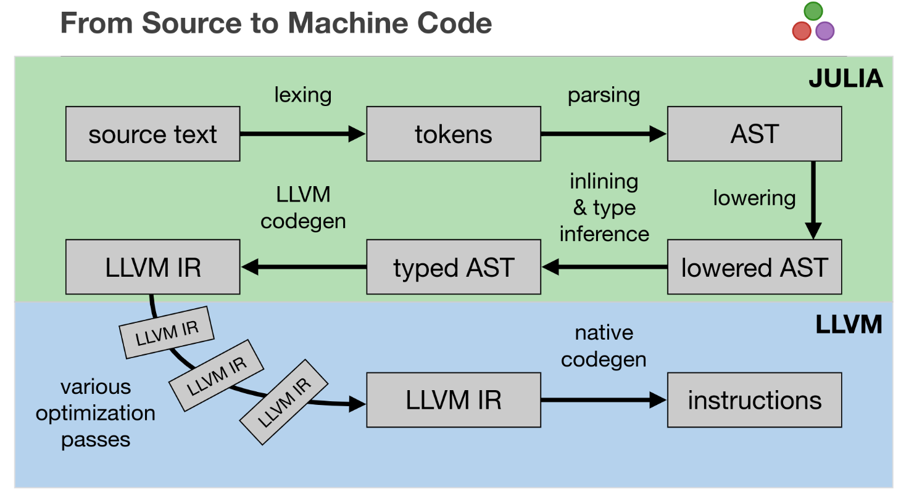

Slide 22
Recommended talks
Nick Eubank: What Julia Offers Academic Researchers
George Datseris: Why Julia is the most suitable language for science

Slide 23
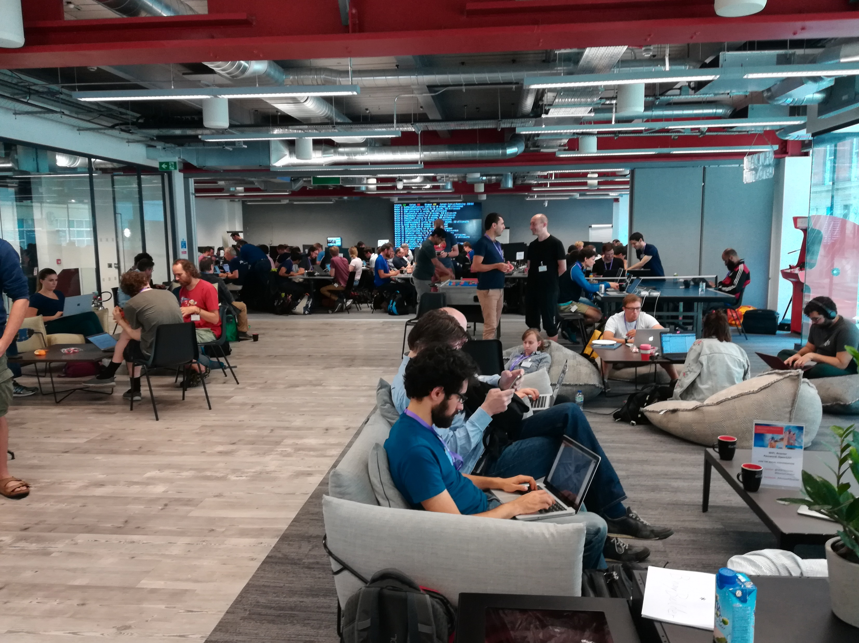




2018

